Slide 1
Gradle Build Tool Fundamentals
SETTING UP GRADLE IN YOUR ENVIRONMENT

Slide 2

Why This Course?
Java has multiple build tools
Ant and Maven
Gradle is better
In my opinion of course ☺
Understand how to use Gradle

Slide 3
What's in this Course?
Setting up and using Gradle
Using Gradle to build Java (and Kotlin) applications
Dependency management

Slide 4
What Is Gradle?
Convention based build tool
DSL to describe the build
Supports multi- project builds
Easily customizable
Builds many languages
Supports dependencies

Slide 5
XML based 'Script'
Ant
Hard to read
Difficult to maintain

Slide 6
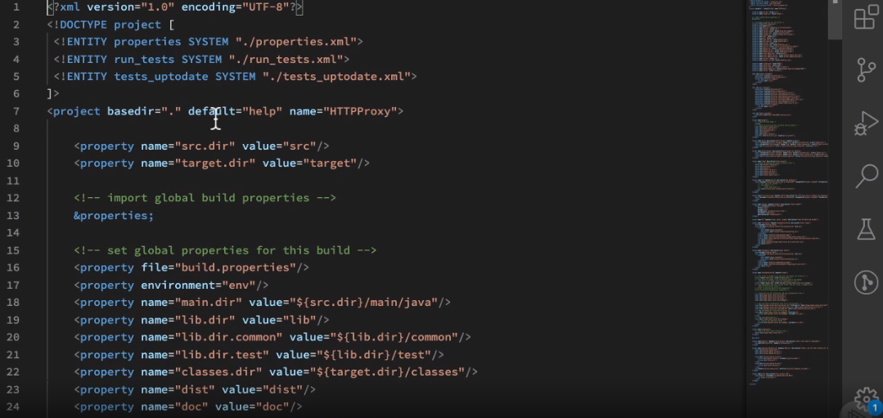

Slide 7
XML based
Supports dependencies
Same issues as Ant
But
It is the standard!
Maven

Slide 8
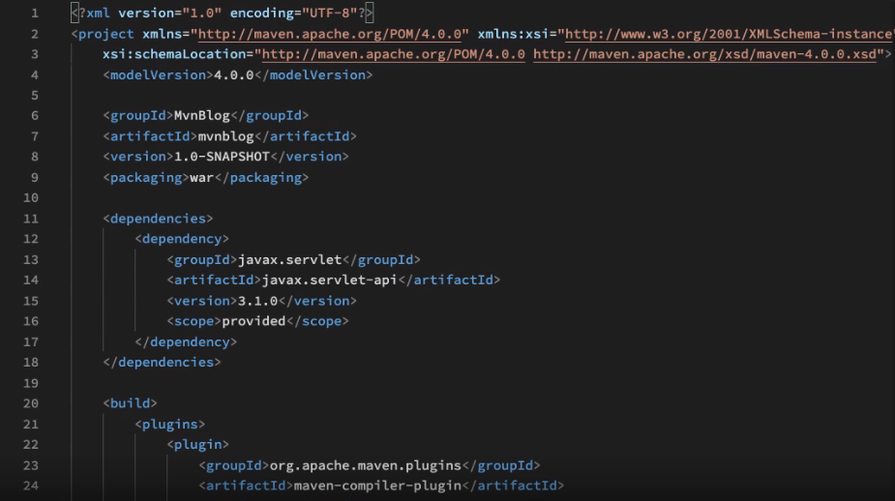

Slide 9
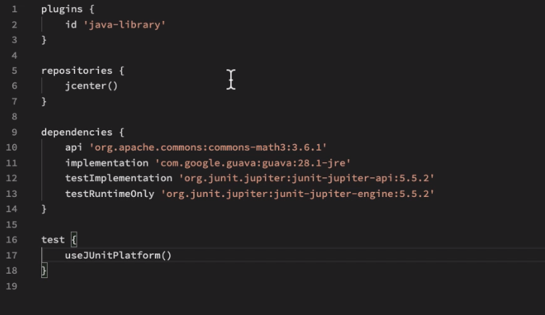

Slide 10
From the web site
All platforms
SDK manager
*nix platforms
Can also install on Cygwin etc...
Homebrew
Mac
Installation

Slide 11
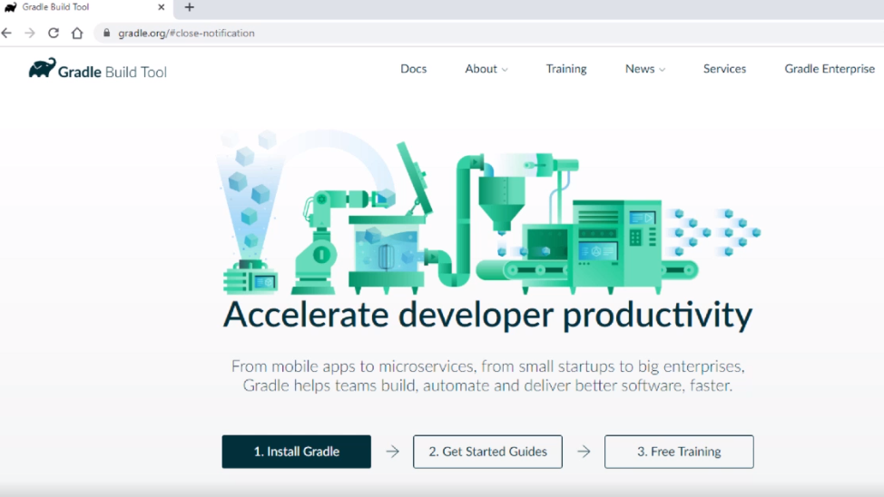

Slide 12
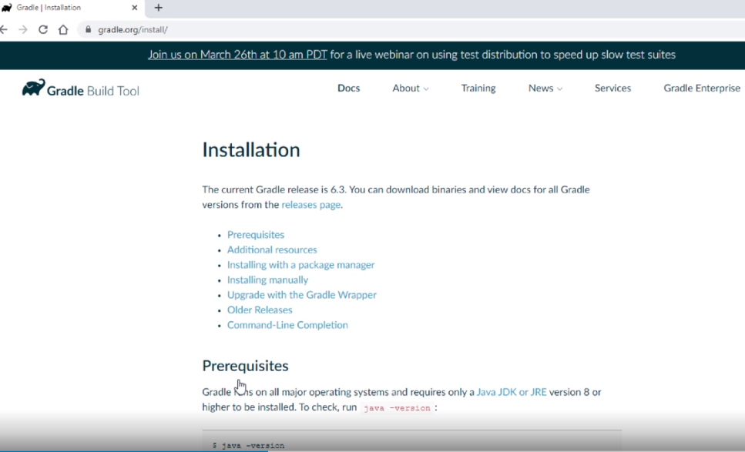

Slide 13
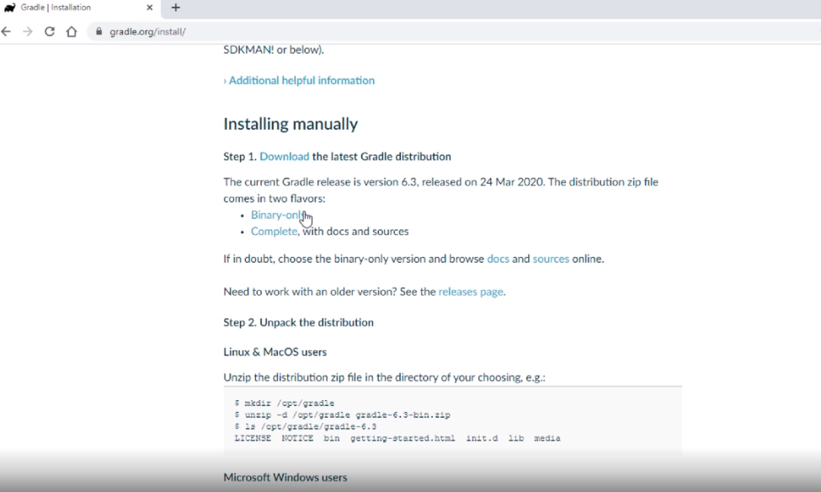

Slide 14
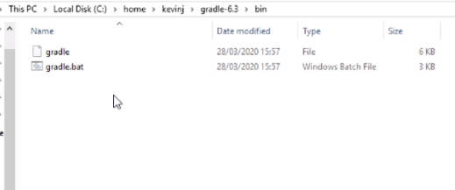

Slide 15
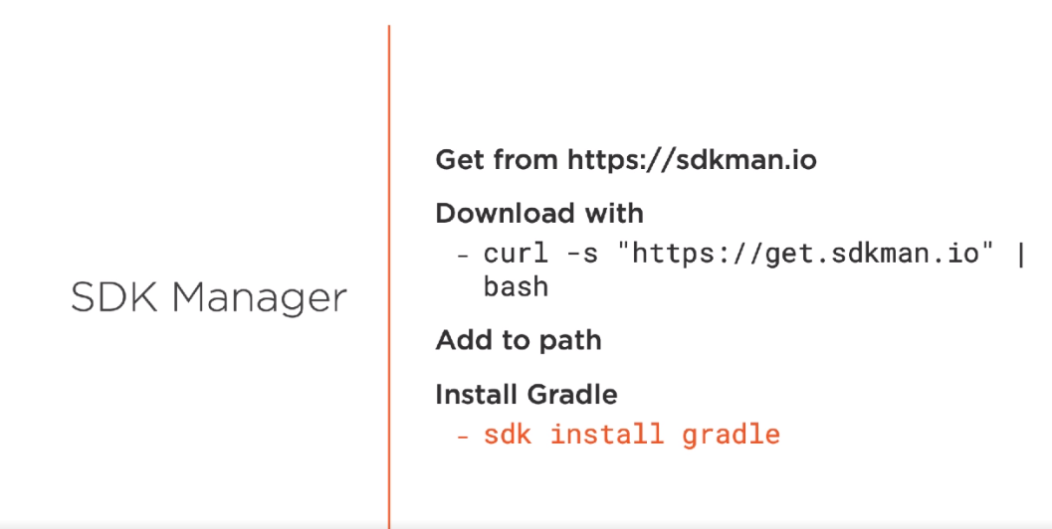

Slide 16
Create a build script
Kotlin or Groovy DSL
This defines tasks
build, clean, etc...
Run the appropriate task
From the command line or an IDE
How Is Gradle
Used?

Slide 17
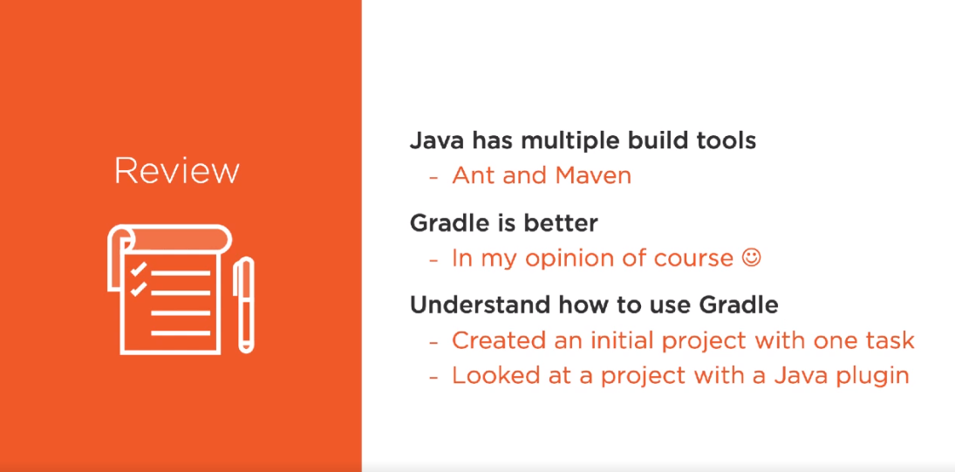

Slide 18

What's Next?

